Slide 1
CYCLISTIC BIKE-SHARE
ANALYSIS
Presented by
Rebbufred RJ

Slide 2






Excel CSV format
Data Sources Used
Summary of analysis
Top 3 recommendations
01
02
03
04
05
06
Business Task
Documentation
Visualizations
Identify the factors that influences the members to opt annual memberships

Slide 3
Cleaning and manipulation of data
Split Function
Trip Duration
Extract Function
Measures table
Separated the time datatype from the combined daytime datatype
Created a calculated column to extract the month name and day from the date datatype
Created a dedicated calculated column to find out the trip duration
Avg distance travelled
Avg trip duration
Count of casuals
Count of members
Membership conversion rate
Membership type distribution

Slide 4
Summary of the analysis
Trend analysis
Membership contribution
Utility vs leisure
Member count vs Ride ID
Rate of Increase in the usage of e-bikes even though the membership is at nascent level
Docked bike is used for leisure based usage but e – bike is used for utility based usage
Docked bike contributes nearly 77% of annual memberships
Member count is low with respect to the total amount of rides with e-bike where as in docked bike, the rides is not to high.

Slide 5
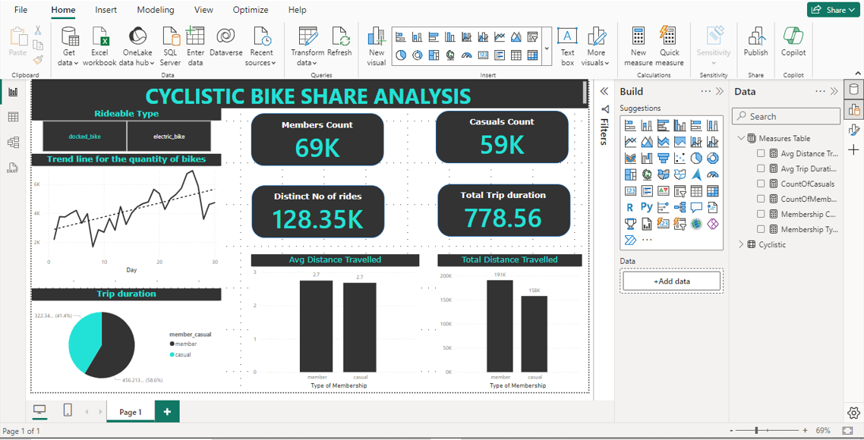
Visualization (through Power BI)

Slide 6
Top 3 recommendations
Focus towards docked bike
Utility demanding locations
Focusing on CSR
42% of the members of docked bike are casual members. So, by focusing more on our presence in tourist places and college campuses, we can increase the annual memberships
By educating the public about the health benefits of riding a cycle results in CSR of our organization
Since the difference in distance travelled by two bikes are not to big, by positioning e-bikes in hilly areas, areas with narrow spaces would result in increase of the memberships

Slide 7
THANK YOU

